Slide 1
E-MAIL

Slide 2
Number of Years to reach 50 million users
Radio: 38 years
Personal Computers: 16 years
E-mail/Internet: 4 years
(Source: From Macintyre 2002).
For an excellent article on the shifts to electronic mail and its revolutionary effect on business, see http://www.emc.com/information/in_depth_archive/12112000_posthaste.jsp

Slide 3
Advantages of E-Mail
Time
Could be sent to more than one person
Convenience
Internal/External
Cost Effective
Documentation

Slide 4
E-mail Limitations
Email is anonymous
Email cannot be retracted
Email can not be tracked
Junk or Spam emails
Lack of Privacy (Disclaimers)
Misunderstandings or Erroneous Messages
Casual Unprofessional Tone

Slide 5
Abbreviations
B/C – Because
C-Ya - See ya
D/L – Download
Esp – Especially
IC – I see
B4 – Before
UR – You’re

Slide 6
Acronyms
AAMOF –as a matter of fact
BBFN – bye bye for now
CMIIW – correct me if I’m wrong
IAE – in any event
OIC – oh, I see
TTYL – talk to you later
TYVM – thank you very much
MGB – May God Bless

Slide 7
Abbreviations
2 – To/Too
IOW – In other words
TIA – Thanks in advance
BTW – By the way

Slide 8
Common Emoticons
:) – happy face to show agreement
:( - sad face to show unhappiness
;) – winking face to show sarcasm
:-0 – startled shock or amazement
%-) - confusion
:-X – lips sealed for confidentiality

Slide 9
<G> - grinning
<J> - joking
<L> - laughing
<S> - smiling
<Y> - yawning

Slide 10
Techniques for writing effective e-mail messages
Recognize your audience
Reply Swiftly
Identify yourself (create a .sig file) and the topic
Use the correct e-mail address
Provide an Effective Subject line (…Tech Prep Conference ?)
Keep your e-mail message brief/Be concise
Organize your e-mail message
Use highlighting techniques sparingly
Proofread your e-mail message

Slide 11
Make hard copies for future reference
Be careful when sending attachments
Do not automatically reply to all recipients
Practice Netiquette( Be courteous, Avoid abusive, angry e-mail messages-flaming)

Slide 12
An Angry E-Mail
‘’We are getting less then 40 hours of work from a large number of employees. The parking lot is sparsely used at 8 A.M.; likewise at 5 P.M. As managers, you either do not know what your EMPLOYEES are doing or you do not CARE. In either case, you have a problem and you will fix it or I will replace you”.

Slide 13
Flaming E-mail
“Never in my career have I allowed a team which worked for me to think they had a 40-hour job. I have allowed YOU to create a culture which is permitting this. NO LONGER.”
Source: From Broughton 2001, online.

Slide 14
To reduce email communication problems:
Resist the temptation to fire off a response. Read the original message again. You might be misinterpreting the message by the sender.
Draft a response and let it cool off for a time before sending it. Reconsider your response again after a walk to the coffee or ice cream shop.
Break the cycle of message and response. A telephone call or personal conversation can do wonders in resolving difficulties.
Respond to opinion with evidence or facts that are relevant.
Source: http://www.library.yale.edu/training/netiquette/

Slide 15
Never try to hold large-scale discussions over e-mail.
Never use the company’s e-mail system to convey sensitive information or controversial ideas to more than a handful of trusted lieutenants (Wong, 2001)
( Technical writing – Gerson and Gerson)

Slide 16
Some do’s and don'ts
Never divulge your user name or password to others.
Immediately delete email with attachments from senders you do not recognize. It is most likely "spam". Do not click open web links in messages from unknown sources.
Do not forward personal email without the author's knowledge and permission
Do not forward chain letters. Delete them.
Keep acronyms to a minimum. They can be confusing to your readers.
Delete unwanted messages to conserve space.
Never answer "spam". Your response will confirm your email address. Delete the message instead.
Source: http://www.library.yale.edu/training/netiquette/

Slide 17
Keep your paragraphs short and place blank lines between each paragraph. This allows your reader to scan your message quickly.
Do not capitalize whole words that are not titles. Capitalizing is generally interpreted as SHOUTING to your reader.
Avoid overuse of the "highest priority" option.
Place a table of contents at the top of your message if you have several detailed pieces of information to convey. Documents should be placed in an attachment.
Use an *asterisk* around a word to emphasize a point.
Get your most important points across quickly! Place your most important information in the first paragraph.
Descriptive subject lines get attention.
Source: http://www.library.yale.edu/training/netiquette/

Slide 18
Create single subject messages whenever possible.
Limit sentence length to 20 words or two lines.
Use bullets or numbers and short paragraphs whenever possible. The more succinct your message is, the more likely your email will be read, understood and acted upon.
Use "active" rather than "passive" voice when possible.
Use emoticons sparingly. They are not appropriate for formal business communications.
Avoid misinterpretation of dates by spelling out the month. Example: 24 Jun 2013 or Jun 24, 2013 Source: http://www.library.yale.edu/training/netiquette/

Slide 19
Creating a signature file
To create your new signature in Eudora, do the following:
From the Tools menu, choose Signatures or click the Signature window's tab if it is the inactive window in a tabbed group. The Signature window appears.
Right-click anywhere inside the Signature window and choose New from the context menu (right-click). Eudora displays the Create New Signature dialog box, and asks you for a name.
In the dialog box, enter a signature name and click OK. A signature window appears.
Enter your signature text in the signature window. To format the text with styles, use the text style buttons on the Eudora message window icon bar.
Save the signature file using the File menu Save command.
· Close the signature window. . Source: http://www.library.yale.edu/training/netiquette/

Slide 20
Effective e-mil message checklist
Does the email use the correct address?
Have you identified yourself?
Did you provide a effective subject line? Include a topic and a focus.
Have you effectively organized your e-mail message? Include introduction, body and conclusion.

Slide 21
Have you used highlighting techniques sparingly?
Avoid boldface, italics, colour, or underlining.
Use asterisks(*) for bullets, numbers, all caps, and double-spacing for access.
Did you practice netiquette?
Be polite,courteous, and professional.
Do not flame.

Slide 22
Is the email concise?
Did you identify and limit the size of attachments?
Does the e-mail recognize audience?
Did you avoid grammatical error?

Slide 23
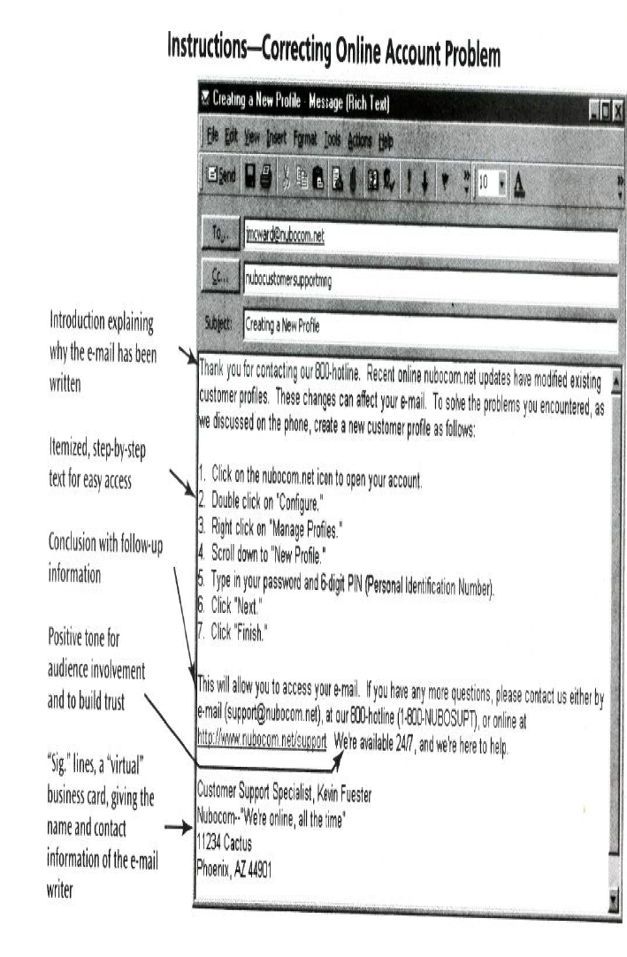

Slide 24
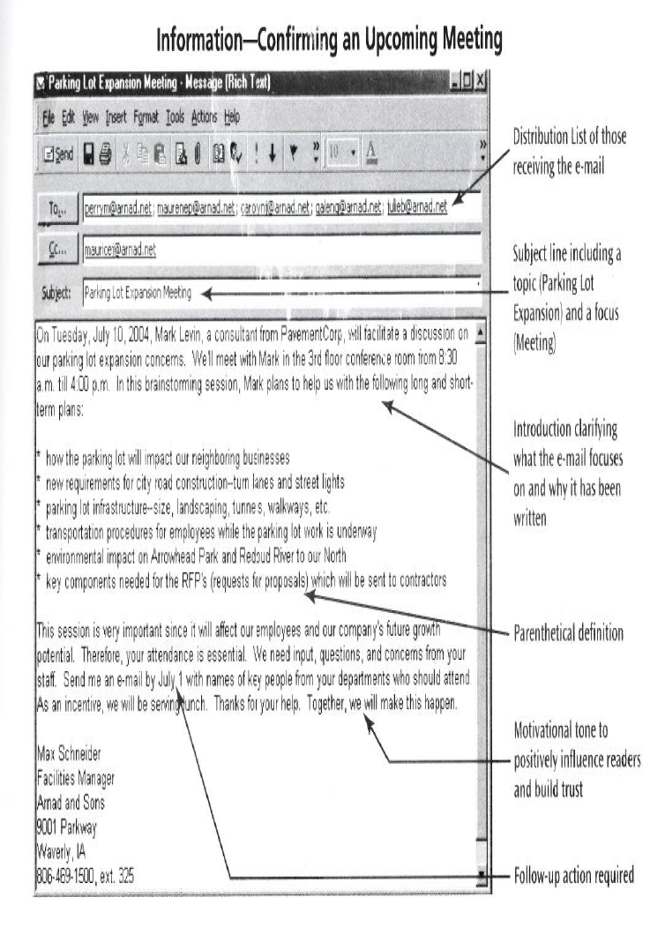

Slide 25
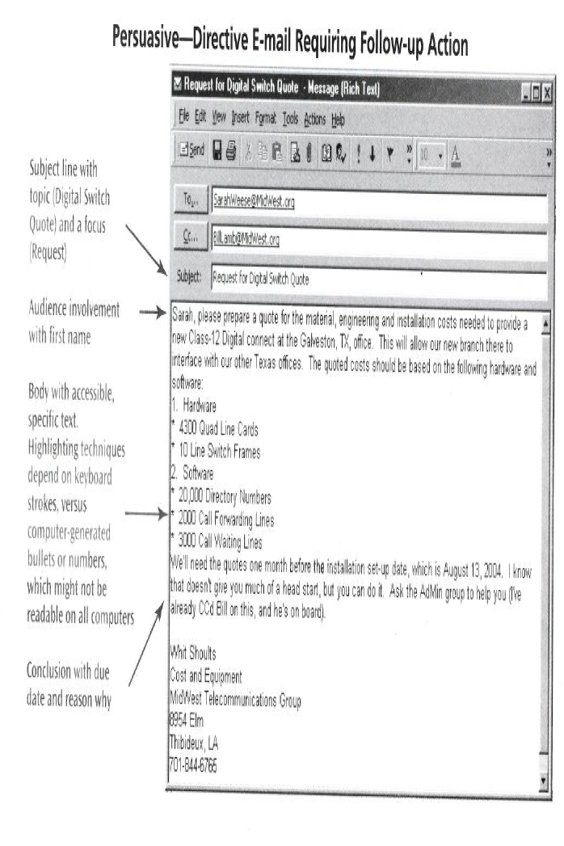

Slide 26
Check these out
http://admin.fgcu.edu/compservices/policies3.htm (E-mail use at Florida Gulf Coast University)
http://www/dbs.umd.edu/records/emailpolicies.html (E-mail policies at many universities)

Slide 27
Assignment
An employee (Akash) attended a work-related conference in another city. He received company financial support for this job-related travel. Another work colleague(Aarti), who also attended the conference, claimed that Akash had not attended all of the conference sessions, using his time to visit the city’s tourist attractions instead. Akash’s boss, Amit, had to address this accusation.

Slide 28
How should he handle the situation? Should he write a memo to Akash, an e-mail to Arti, or visit Akash personally? Write an e-mail or memo to your instructor explaining your answer. Or, make a brief oral presentation. Be sure to give reasons for and against each option.

